Slide 1
2 Factor Authentication
Members:
ALI RAZA-BITF20M010
NUMEER QADRI-BITF20M021

Slide 2
AGENDA
Introduction
Why do we need it?
How we design it?

Slide 3

Two-Factor Authentication (2FA)
A security process that requires users to provide two different authentication factors before gaining access to a system or account.

Slide 4
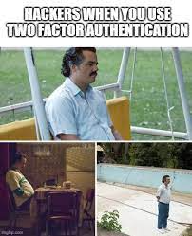
Why do we need it?
Enhanced Security
Defense Against Cyber Attacks
Protection Against Unauthorized Access
Ensuring Data Integrity
Increasing Difficulty for Cybercriminals

Slide 5
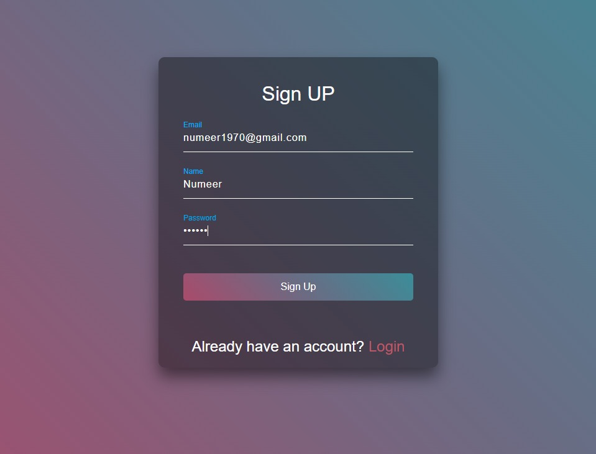
How We Design it?
1-Sign UP:
User can signup through
Email, name and password.
If email already exist then user
Render to same page with error.

Slide 6
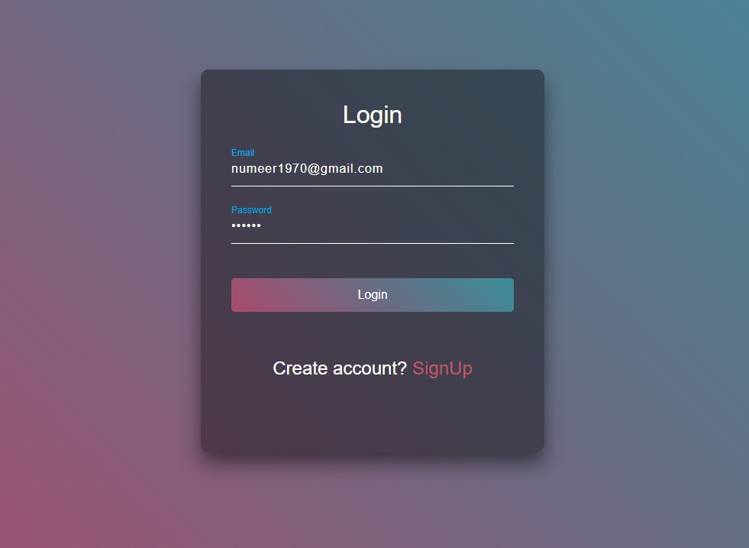
Cont….How We Design it?
2-Login:
After successfully registered,
User can Login to the system.

Slide 7
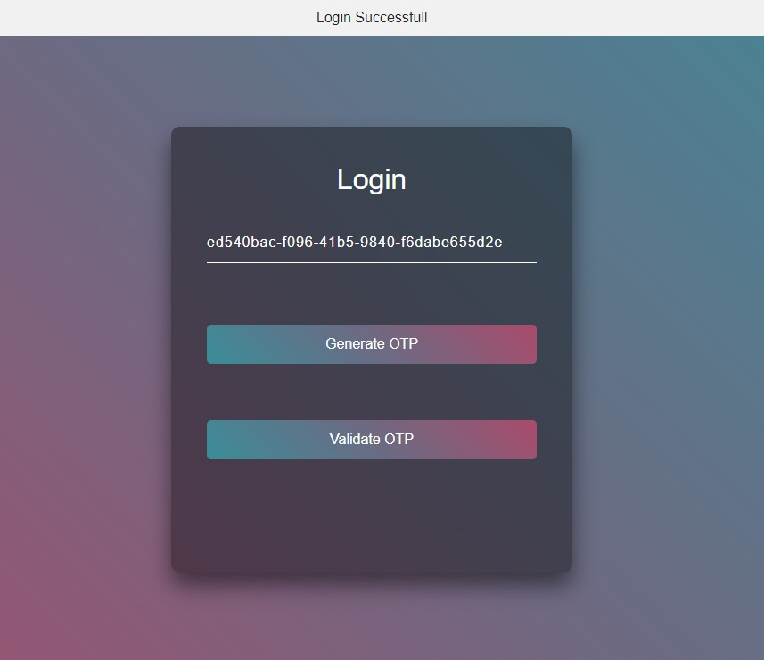
Cont…. How We Design it?
3-Generate OTP:
After login successfully, if the user is not registered, then he/she click on generate otp
and get token through codevoweb.
For registered users validate otp option.

Slide 8

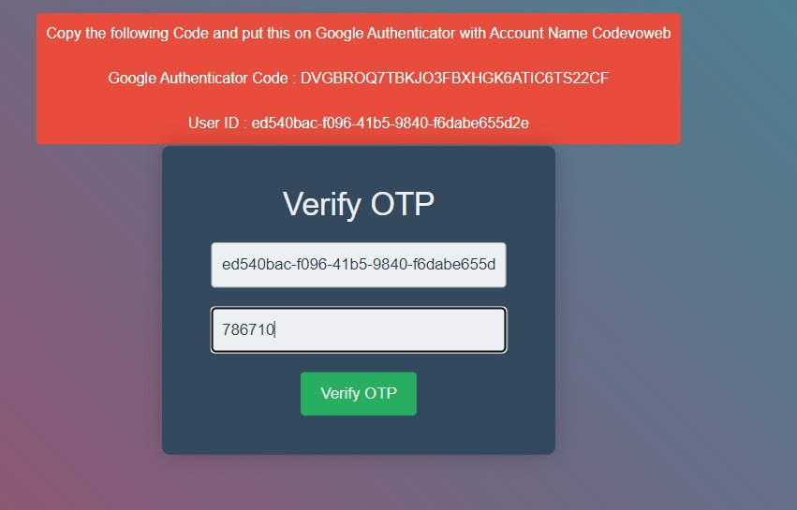
Cont…. How We Design it?
4-Verify OTP:
Copy the GA Code and paste it on Google authenticator with account name codevoweb.
User will enter his ID and OTP which is generated through above step and verify it.

Slide 9
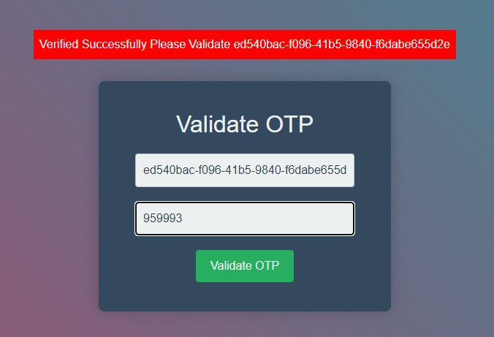
Cont…. How We Design it?
5-Validate OTP:
User will enter his ID and OTP from Google Authenticator app and validate it.

Slide 10
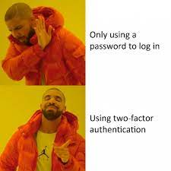
THANK YOU

